Slide 1
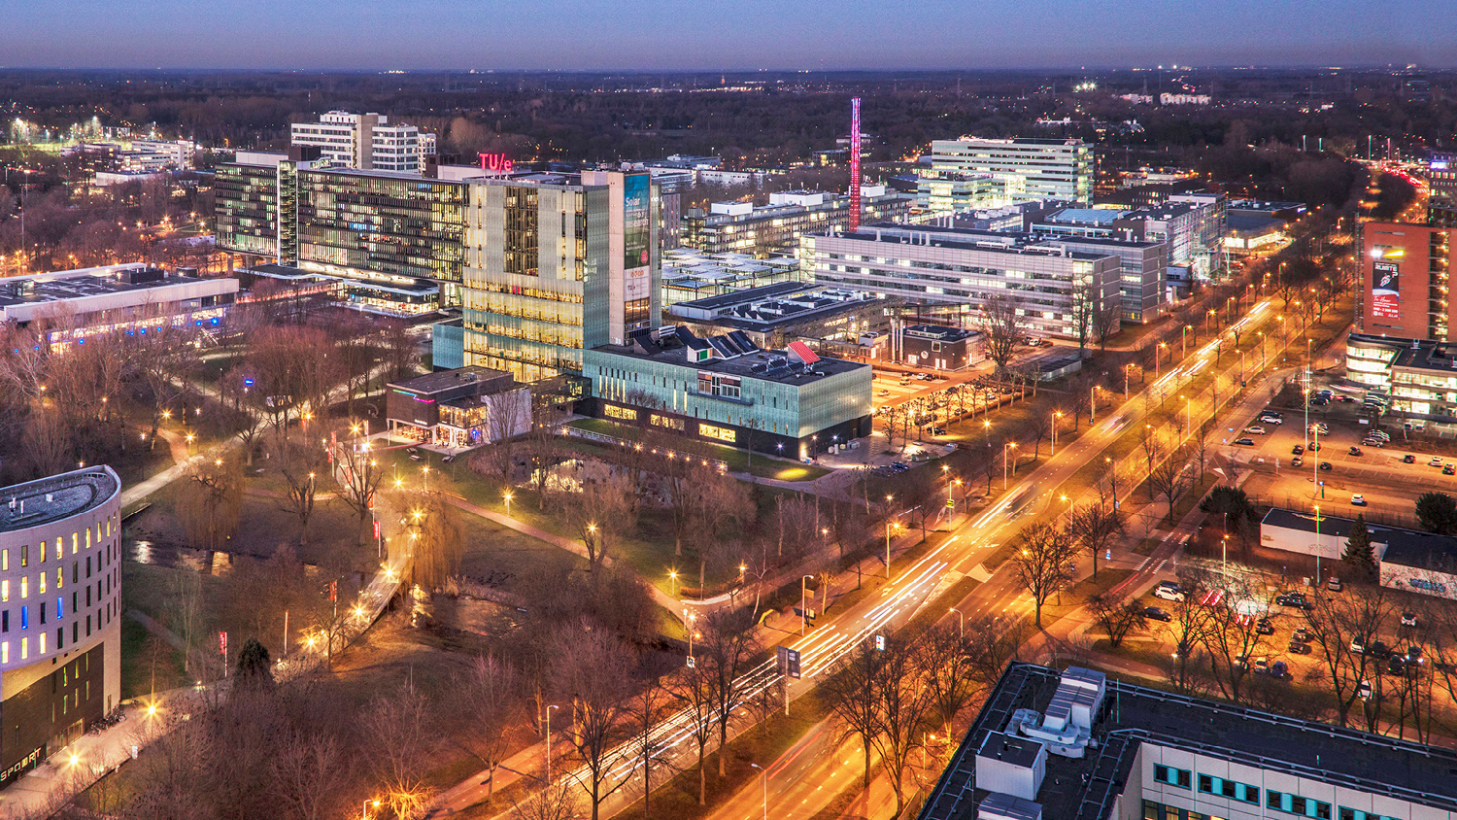
Workflow
Seb
IMAG\e
Notes:
<number>

Slide 2
Small introduction
Python icon (Pytorch) Slurm icon
Pycharm icon Github/gitlab
Vim Matlab
Jupyter notebooks Julia
UMCU Servers TU Eindhoven servers (RIP Saruman, Boromir, Legolas, ...)
<number>
Title of the presentation - by tab Insert -> Header text and Footer text
Notes:
<number>

Slide 3
The philosofy
Structure of your code
Model pipeline
<number>
Title of the presentation - by tab Insert -> Header text and Footer text
Notes:
<number>

Slide 4
Structure of your code
A git-repository per project
+ Easy to share
- Where is function XYZ?
A git-repository for all your projects
The inverse
<number>
Title of the presentation - by tab Insert -> Header text and Footer text
Notes:
<number>

Slide 5
Structure of your code
Inside the repository you need the following folders
Data exploration
Pre-processing
Model run
Post-processing
Visualization
Also, use a file/folder to define your paths and other global parameters. This makes changing from an environment and plotting very easy.
<number>
Title of the presentation - by tab Insert -> Header text and Footer text
Notes:
<number>

Slide 6
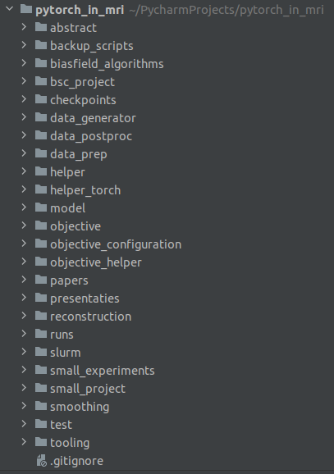
Structure of your code
Example of my folders...
<number>
Title of the presentation - by tab Insert -> Header text and Footer text
Notes:
<number>

Slide 7
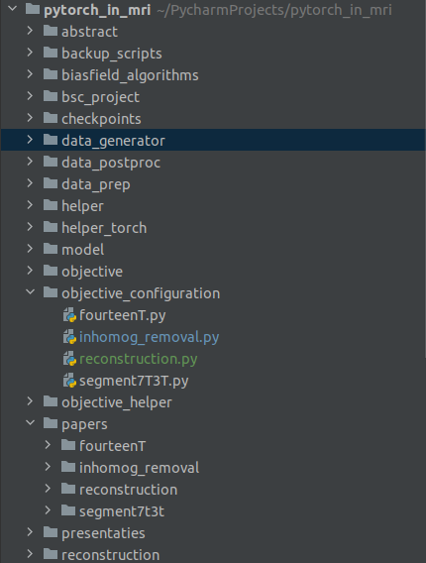
Structure of your code
Example of my folders...
<number>
Title of the presentation - by tab Insert -> Header text and Footer text
Notes:
<number>

Slide 8
Model pipeline
I wanted to have full control of all the options that are present when training a deep learning model.
For this I created a configuration setup using multiple .json files
One for Data Generator options
One for Training options
One for Model architecture options
This is all combined into one config_run.json file that I use to… run my models.
<number>
Title of the presentation - by tab Insert -> Header text and Footer text
Notes:
<number>

Slide 9
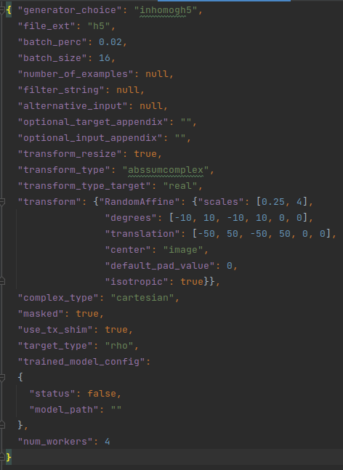
Model pipeline
Snippet of the Data Generator json
<number>
Title of the presentation - by tab Insert -> Header text and Footer text
Notes:
<number>

Slide 10
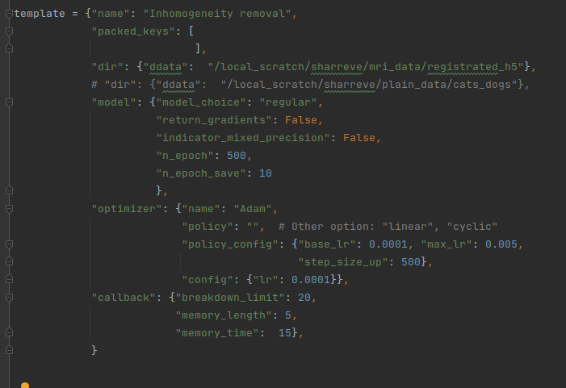
Model pipeline
Snippet of the
training options
<number>
Title of the presentation - by tab Insert -> Header text and Footer text
Notes:
<number>

Slide 11
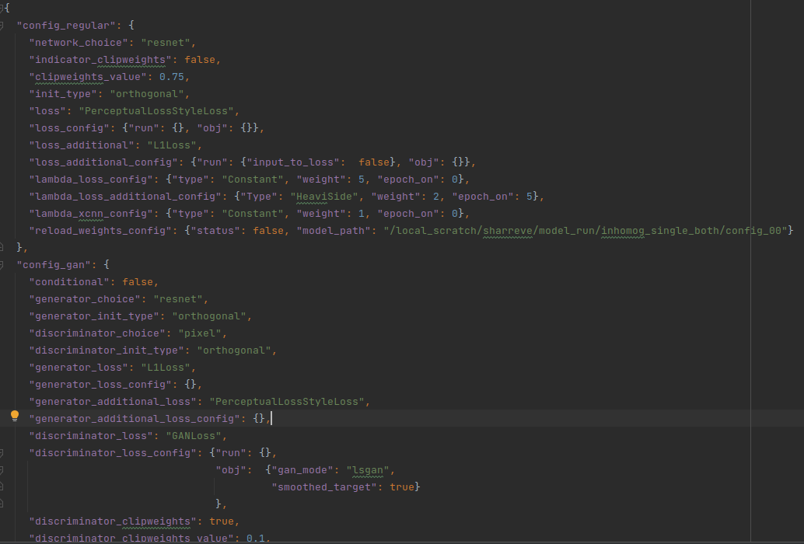
Model pipeline
Snippet of the
model architecture
options
<number>
Title of the presentation - by tab Insert -> Header text and Footer text
Notes:
<number>

Slide 12
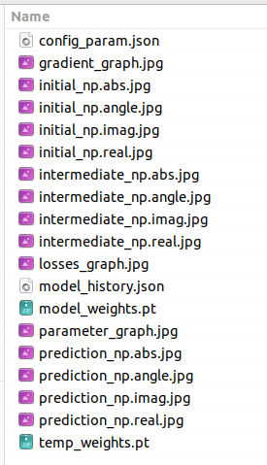
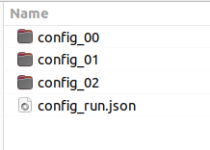
Model pipeline
Output of this model pipline
<number>
Title of the presentation - by tab Insert -> Header text and Footer text
Notes:
<number>

Slide 13
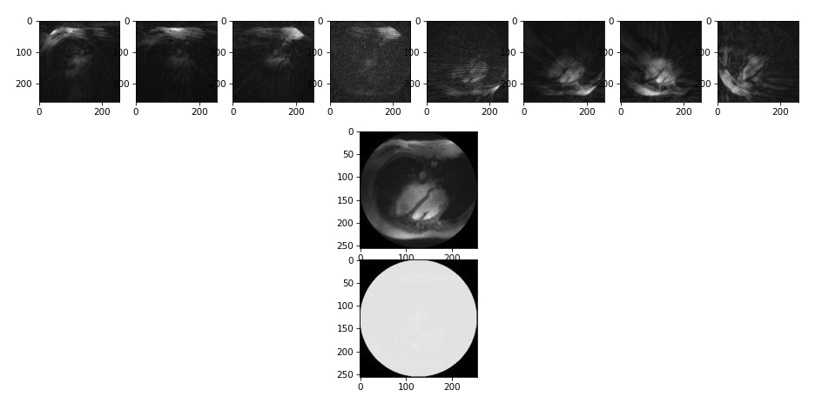
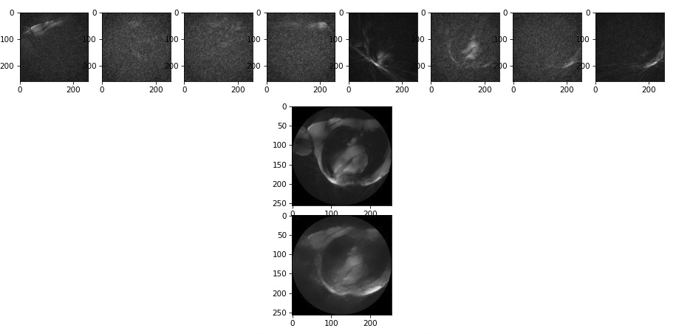
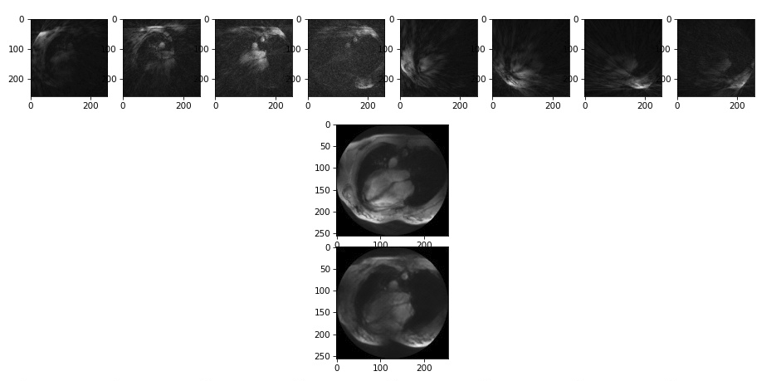
Model pipeline
<number>
Title of the presentation - by tab Insert -> Header text and Footer text
Notes:
<number>

